Slide 1

Aligning Our Efforts in Yavapai County
Economic
&
Workforce Development
Notes:
https://unsplash.com/photos/m5P0c6ABWDs

Slide 2
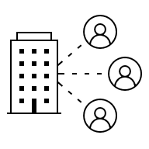


WORKFORCE DEVELOPMENT & ECONOMIC DEVELOPMENT
BUILDING PEOPLE
Producing Skilled Talent
Upskilling Talent
Increasing Employability
Decreasing
Unemployment
& Underemployment
WORKFORCE DEVELOPMENT
SUSTAINABLE ECONOMIC VITALITY & REGIONAL PROSPERITY
ECONOMIC DEVELOPMENT
BUILDING ECONOMIES & COMMUNITY
Fostering Business Investment
Increasing Tax Base
Attracting Industry
INTERDEPENDENCE & INTERCONNECTION

Slide 3


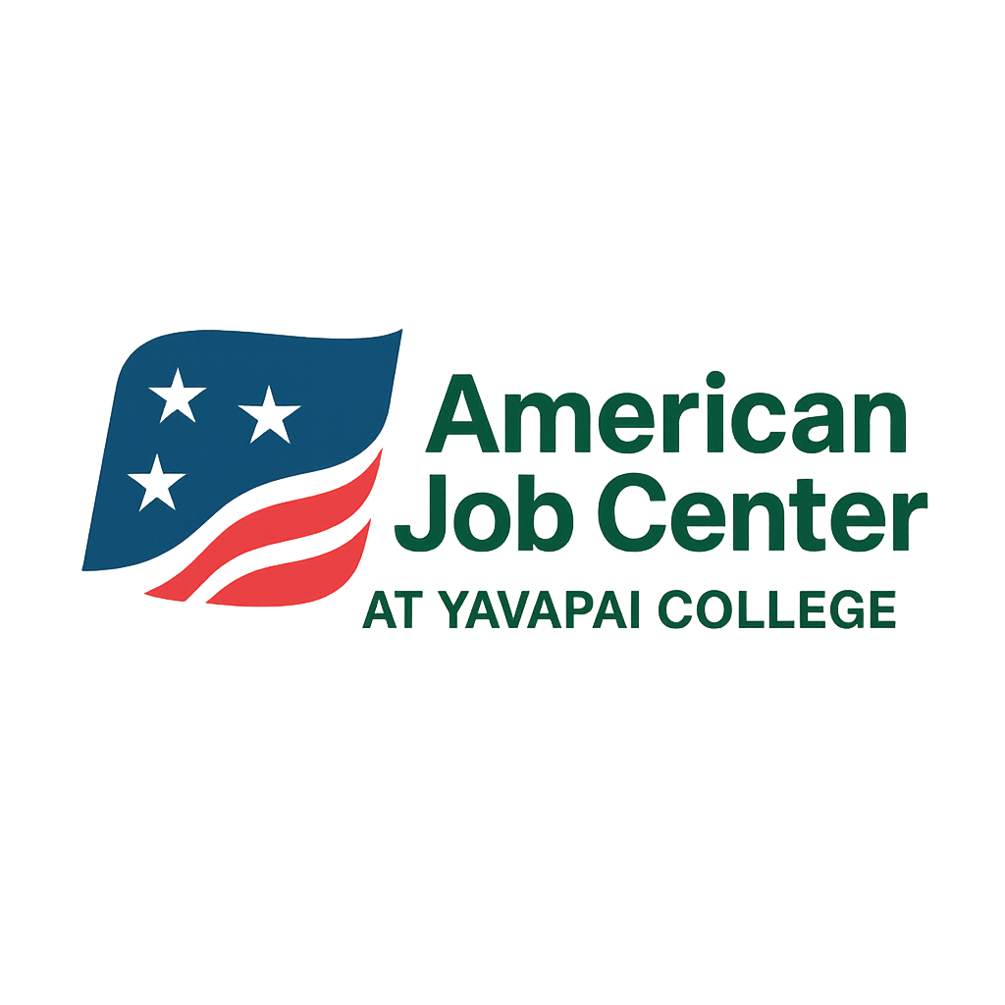

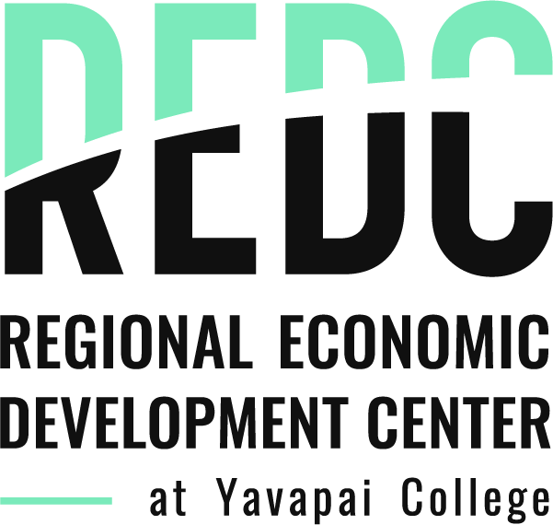
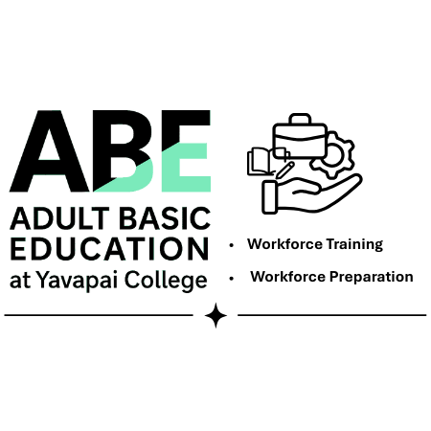

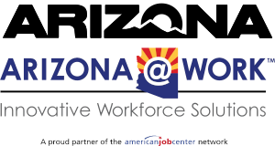
‘The Yavapai County Workforce and Economic Development Ecosystem’
Yavapai College - County Partnership
Yavapai County Board Of Supervisors
County Manager
Yavapai County Community Health Services
Department Head
Town of Chino Valley
Economic Development
Yavapai College
Vice President of Workforce Development & Health Sciences
Yavapai County Workforce Development Board
Director
Town of Dewey-Humboldt
Economic Development
A collaborative regional partnership dedicated to advancing the implementation of the Western Yavapai County Economic Development Strategy
Town of Camp Verde
Economic Development
The central hub for business and economic development in the Verde Valley.
City of Prescott
Economic Development
Industry
Town of Clarkdale
Economic Development
Industry
City of Prescott Valley
Economic Development
City of Cottonwood
Economic Development
Chambers of
Commerce
Embry Riddle
Aeronautical
University
Town of Jerome
Economic Development
Chambers of
Commerce
Yavapai-Prescott
Indian Tribe
Prescott
College
City of Sedona
Economic Development
Yavapai-Apache
Nation
Yavapai County
K -12
Arizona Department of
Economic Security
s
Workforce Development
Economic Development
Housing
Transportation
Child Care
Foundational Infrastructure
Foundational Infrastructure for Workforce Participation & Economic Mobility
essential, enabling elements that directly impact an individual's ability to access, maintain, and thrive in employment

Slide 4
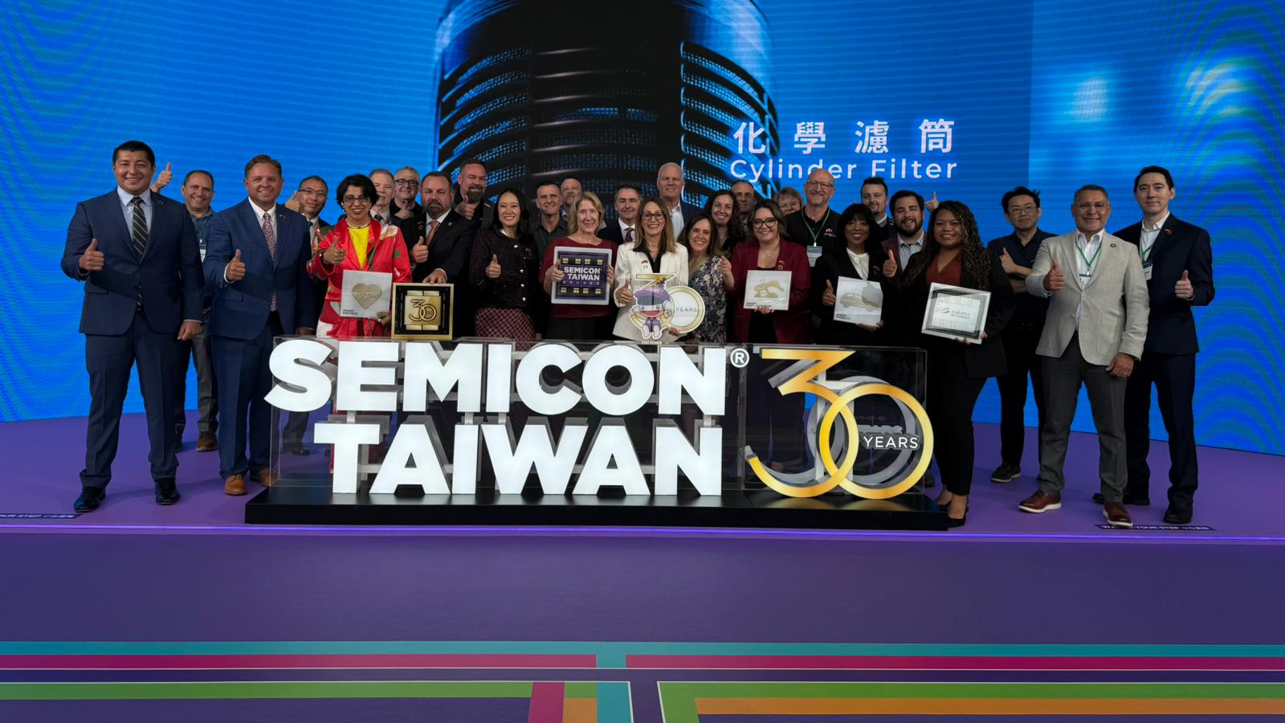
Arizona Taiwan Delegation 2025

Slide 5
What exactly is going on with TSMC & Chips?
Expanded raising TSMC’s
total investment to ~$165 billion.
165 B
expansion
Fabs, R& D, &
packaging
TSMC original investment of $65 billion in
building advanced semiconductor fabs
in Phoenix
The CHIPS and Science Act
is providing federal
funding and incentives
Fed CHIPS
&
Science Act
65 Billion
Fabs
Investment
1 Santa Clarita Valley Signal+3TSMC+3Arizona Commerce Authority+3
2 Arizona Commerce Authority+2TSMC+2
3 Arizona Commerce Authority+1
Notes:
TSMC is investing over $65 billion in building advanced semiconductor fabs (“fabs” = factories for making chips) in Phoenix, including multiple “leading-edge” fabs.
This is now being expanded: there was another announcement raising TSMC’s total investment to ~$165 billion in greater Arizona, adding more fabs, packaging facilities and R&D centers.
The CHIPS and Science Act (federal) is providing funding / incentives to help support this, aiming to rebuild more of the semiconductor supply chain in the U.S.

Slide 6




Some of the established & reported impacts of TSMC’s investments more broadly in Arizona
Large tax revenues, income increases, and multiplier economic output from the fabs (4)
Over 6,000 direct manufacturing jobs once certain fabs are fully operational (2)
04
Leading-edge fabs, packaging, and R&D facilities. (1)
03
Direct & Indirect Gains
Over 20,000 cumulative construction jobs (3)
02
Jobs in Manufacturing
01
Cutting-Edge Industry
Jobs in Construction
1 theravenscroftgroup.com+3NIST+3TSMC+3
2 NIST+1
3 NIST+1
4 TSMC
Notes:
The investment will include leading-edge fabs, packaging, and R&D facilities. theravenscroftgroup.com+3NIST+3TSMC+3
The estimate is for over 6,000 direct manufacturing jobs once certain fabs are fully operational, plus over 20,000 cumulative construction jobs. NIST+1
The broader Phoenix (Greater Arizona) region is expected to see large tax revenues, income increases, and multiplier economic output (direct + indirect) from the fabs. For example, for the initial ~$65B phases, impacts included ~$32.9B in economic output, ~$9.3B in personal income (direct + indirect), ~$1.4B in tax revenues over ~13 years. TSMC

Slide 7
Spillover likely for 5-20 year period
Supplier clusters, housing, services third
3rd
Second-order
effects
2nd
Operational jobs will come second
Construction Jobs will
come first
1st

Slide 8
Timeline
No official announcement for groundbreaking date for 4th FAB but 1,100 acres site in north Phoenix is designated for up to six fabs
04
2028
2028
03
AP1-First advanced packaging facilities to break ground (4)
R & D-research and development center operational by 2028 (5)
02
2025
FAB 2-Construction is complete, with cleanroom installations underway. Equipment installation is anticipated to begin by the end of Q1 2026, with production starting by late 2026 (2)
FAB 3- Groundbreaking was April 2025, aiming to produce 2nm chips by the end of the decade. (3)
01
2024
FAB 1-Began limited production of 4nm chips (1)
1 SimplyMac
2 Construction Owners
3 Simply
4 Tom's Hardware
5 Axios

Slide 9
Speculative Ten-Year Outlook on Spillover to Yavapai County
Summary of what the TSMC Investment (alone) could imply for Yavapai’s planning over the next 5-10 years — in population, jobs, tax base, and housing
Scenario | Population | Jobs | Tax Revenue | Housing Units
Low Spillover | ~53,000 | ~25,500 | ~$122M | ~29,800
Medium Spillover | ~61,400 | ~29,600 | ~$141M | ~34,600
High Spillover | ~74,400 | ~35,700 | ~$172M | ~42,000
Scenario Summaries (10-Year Outlook)
Note: These numbers reflect compounding annual growth rates over 10 years.

Slide 10







Increased
Demand for
Construction Trades,
Healthcare
& Services
Increased Demand for Housing
Rising Property Values &
Growing
Tax base
Hundreds to Low Thousands of Jobs Over Time
How Big
Could
the Impact
Be for
Yavapai
County?
New
Infrastructure
Requirements

Slide 11
ECONOMIC & WORKFORCE DEVELOPMENT IMPACT OF GROWTH OF THIS MAGNITUDE TO OUR COUNTY
EVERY SOLUTION RAMIFIES THROUGHOUT THE SYSTEM
THERE IS NO CLEAR
PROBLEM DEFINITION
CHALLENGES ARE CAUSAL & INTERCONNECTED
MULTIPLE STAKEHOLDER
WITH CONFLICTING AGENDAS
WICKED
CHALLENGE
STRADDLE ORGANIZATIONAL & DISCIPLINARY BOUNDARIES
CHALLENGE IS NEVER COMPLETLEY SOLVED
EVERY INTERVENTION CHANGES THE SYSTEM
SOLUTIONS ARE NEVER RIGHT/WRONG BUT ARE BETTER/WORSE
Horst Rittel, UC Berkley, introduced as a part of his work on systems thinking arguing that the traditional scientific approaches were not adequate in addressing the complexity & ambiguity of these types of challenges
Notes:
Horst Rittel, a design theorist and professor at UC Berkeley, introduced the concept as part of his work on systems thinking and planning, He argued that traditional scientific approaches were inadequate for addressing the complexity and ambiguity of these types of problems.

Slide 12

“Systems thinking helps us see the big picture, connect the dots, and create smarter solutions that actually stick, particularly for wicked challenges.”

Slide 13

Series of Sessions Planned Utilizing System Thinking
Workforce and Economic Development Summit
1
Mapping stakeholders, boundaries, and barriers
Understanding dynamics and feedback
Identifying patterns and leverage points
Seeing the system
and challenge
Designing systemic interventions
2
3
4
5
6
Aligning metrics and sustaining action
7

