Slide 2
Dr. Megan Hanna, Facilitator
Intro & Purpose

Slide 3
Mary Mallory, Chair
Yavapai County Board of Supervisors

Slide 4
Dr. Lisa Rhine, President
Yavapai College

Slide 5
Dr. Tom Hughes
GSH Education Group

Slide 25
The New Wave: Advanced Manufacturing and Arizona’s Economic Transformation
John Morgan and Vince Redgrave

Slide 39



Do not edit
How to change the design
Is Yavapai County Ready?
The Slido app must be installed on every computer you’re presenting from

Slide 40
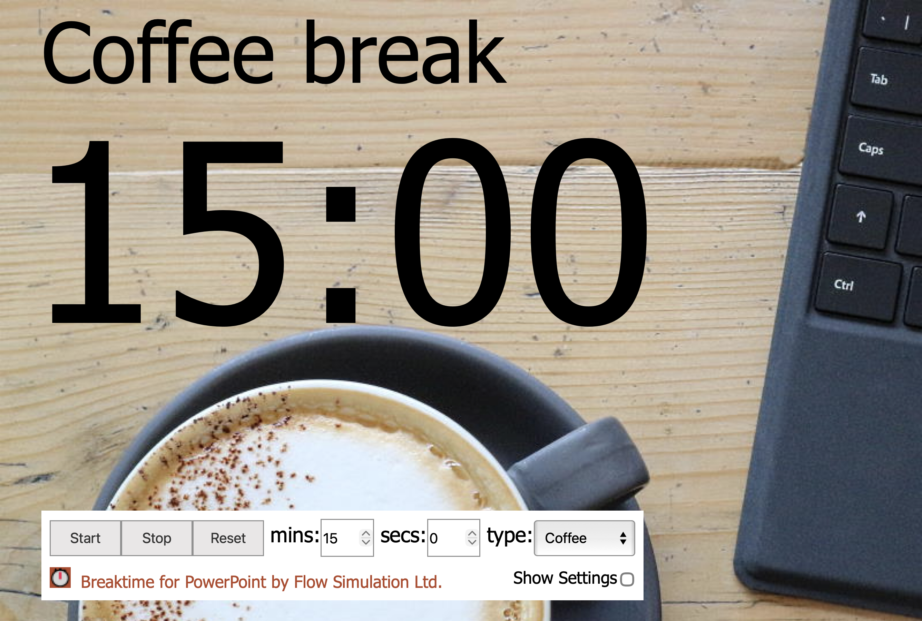

Slide 41
The Regional Workforce & Economic
Development Ecosystem
Dr. Lisa Rhine

Slide 42
Table Discussion Facilitated through
Systems Thinking Framework
Dr. Megan Hanna

Slide 43

Do not edit
How to change the design
What one word describes how you feel about our county’s future right now?​
The Slido app must be installed on every computer you’re presenting from

Slide 44

The Mosaic

Slide 45
Table Discussions
Discuss these questions with your table. Capture 2–3 insights. We’ll share a few out at the end.

Slide 46
Do not edit
How to change the design
What stood out to you from your conversations?​
The Slido app must be installed on every computer you’re presenting from

Slide 47

The Mosaic & Systems Thinking

Slide 48

The Basics
Systems thinking is seeing how the individual parts connect and influence one another over time.

Slide 49

We're part of an interconnected system

Slide 50
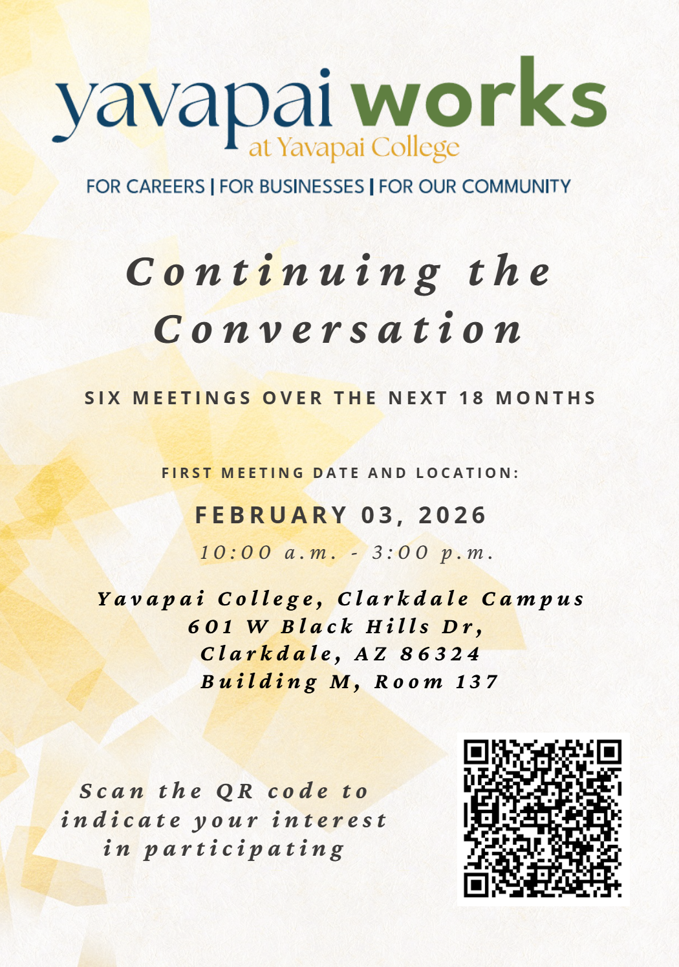
Let's keep the conversation going!

Slide 51
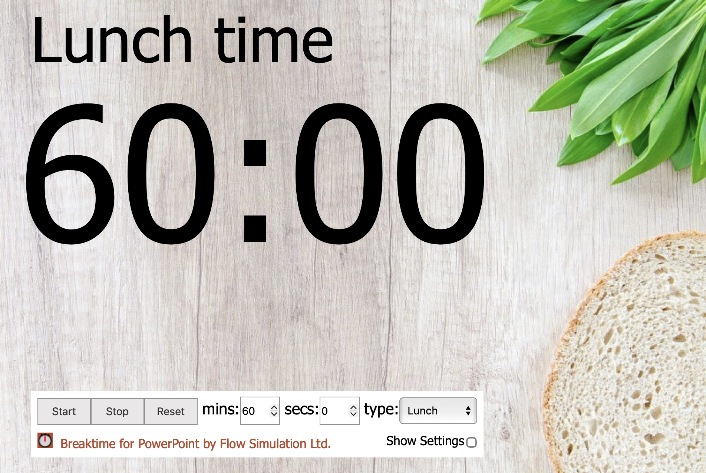
Lunch
Insert countdown timer

Slide 52
Workforce Impact
Chris Kuknyo, Yavapai County Supervisor

Slide 53
Wrap-Up & Next Steps
Dr. Megan Hanna

Slide 54
Questions about these events? Contact:
Dr. Megan Hanna
Email: megan.hanna@yc.edu
Phone: 928-717-7215

Slide 55
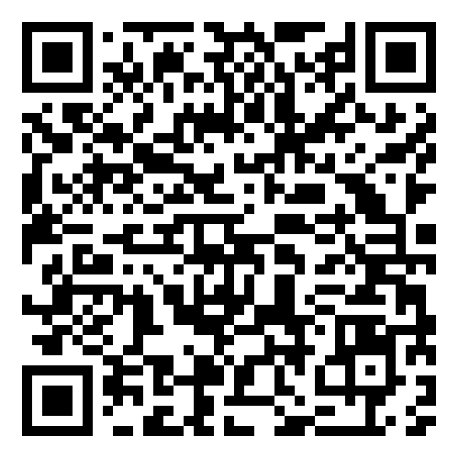
Thank You for Attending
Share your feedback and download the slides:
https://www.yc.edu/wfs

