Slide 1

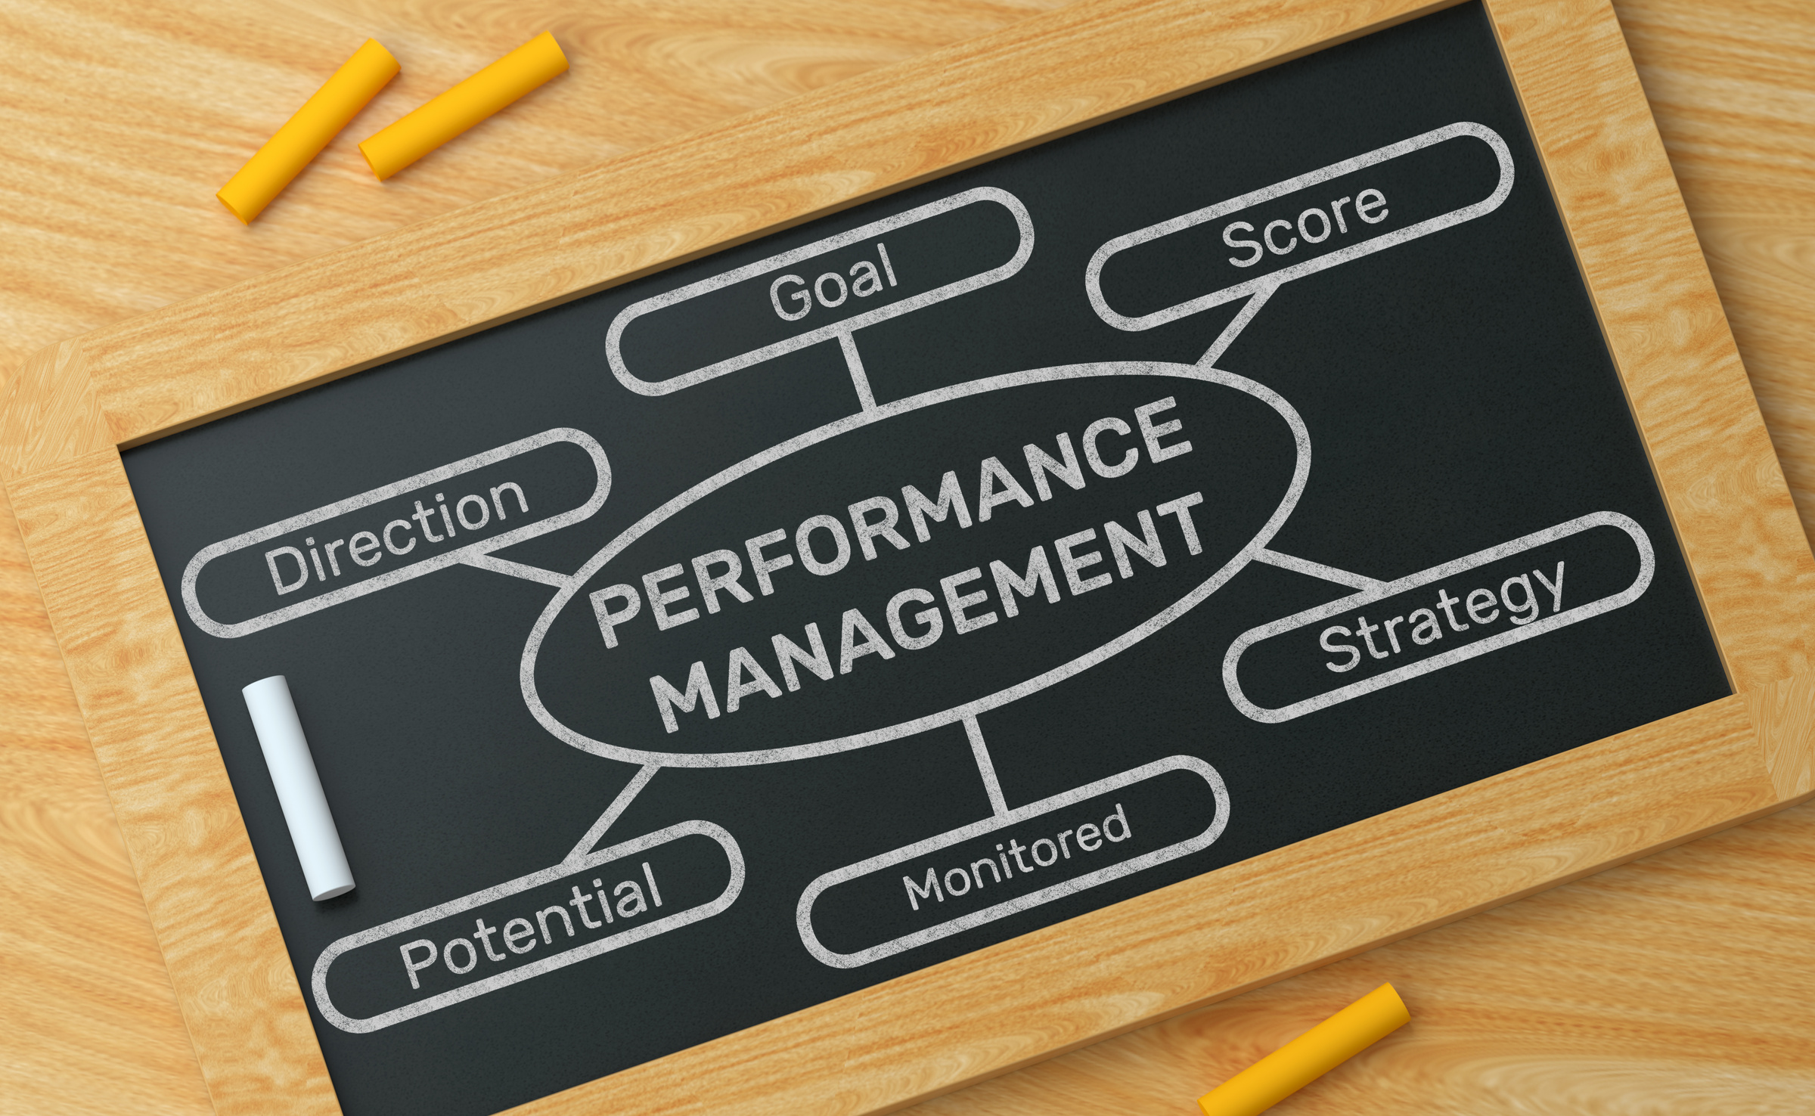
EMPOWERING GROWTH
NAVIGATING A NEW PERFORMANCE MANAGEMENT PROCESS

Slide 2
OBJECTIVES
Understand the “why” behind this change
Learn key components of new process
Provide feedback to help refine process and rollout

Slide 3
CURRENT STATE
Performance meetings and creating goals are currently just a box to check (Puts compliance over development and engagement)
Supervisors and employees are not having growth conversations (lack of regular and meaningful conversations)
Doesn’t reflect or reinforce our core values
Missed opportunities for growth and innovation
Tied loosely to annual increase

Slide 4






NEW APPROACH KEY PRINCIPALS
Performance is a relationship, not a transaction
Focus on feedback conversations, not compliance
Employee-centered and values-driven
Continuous and regular dialogue throughout the year
Not tied to any increase

Slide 5
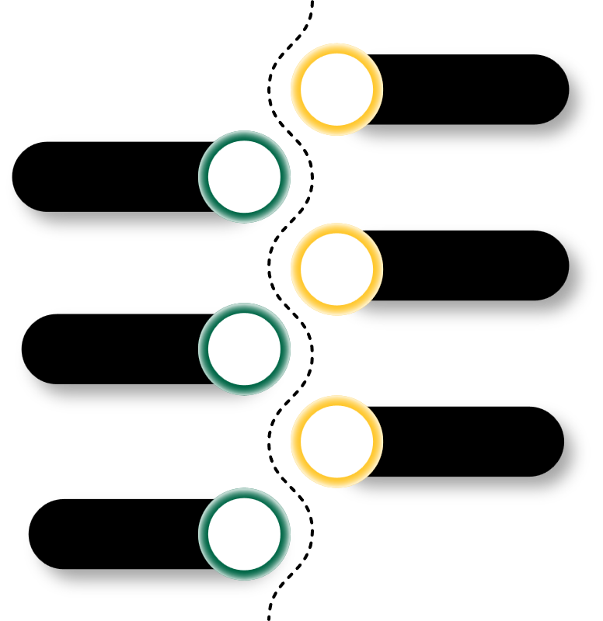
OVERVIEW
01
SEPT. - OCT.
02
Employee goal setting & clarifying expectations meeting w/ employee & supervisor
OCT. - DEC.
Regular check-ins on goals required quarterly between supervisor and employee (Aug., Nov., Feb., & May)
Increased frequency is highly encouraged
Regular check-ins
(bi-weekly, monthly, etc.)
03
JAN. – FEB.
FEB. – APR.
04
Mid-year review, informal, non-scoring
Regular check-ins
(bi-weekly, monthly, etc.)
05
APR. - MAY
Year-end reflection & planning meeting w/ employee & supervisor

Slide 6
CHANGES
Current | New Process
Number rating (1-5) | Not Started, In Progress, Completed
Infrequent, formal compliance meetings | Regular informal feedback and reflection discussions
Tied to raise | Focus on growth and not monetary value
3-5 goals tied to strategic initiative or employee competency | 2 goals tied to employee competencies (1 for relationship excellence & 1 for service excellence) 2 goals tied to strategic initiatives
Notes:
Builds leadership through regular mentoring and coaching opportunities
Cultivates growth mindset

Slide 7
NEW FEEDBACK REFLECTION TOOL
Category | Definition | Behaviors You May See | Growth Focus
Not Started | Has not started actions toward completing goal. Still building knowledge, skills, or confidence in area. Needs additional support and practice. | Inconsistent execution, requires frequent guidance | Identify specific skill gaps and create short-term goals for improvement
In Progress | Taken some actions towards goal completion. Demonstrates growing competence and independence. Sometimes meets expectations, with room to grow. | Sometimes meets expectations, shows initiative, progressing with few reminders or guidance | Focus on consistency, confidence, and moving toward full independence
Completed | Successfully completed goal. Consistently performs at expected level with quality and reliability | Delivers solid, reliable work, demonstrates values in action, requires minimal supervision/guidance | Consider stretching goals, mentoring others, or pursuing innovation in specific area

Slide 8
RESOURCES CREATED
Performance Timeline Overview
Performance Process in Detail with Resources and Actions
Clarity & Initial Priorities Check-in Worksheet (Supervisor instructions separate)
Creating SMART Goals
Asking for Feedback
Check-in Discussion Questions
Self-Reflection & Assessment Questions
End of Year Reflection Facilitation Guide

Slide 9
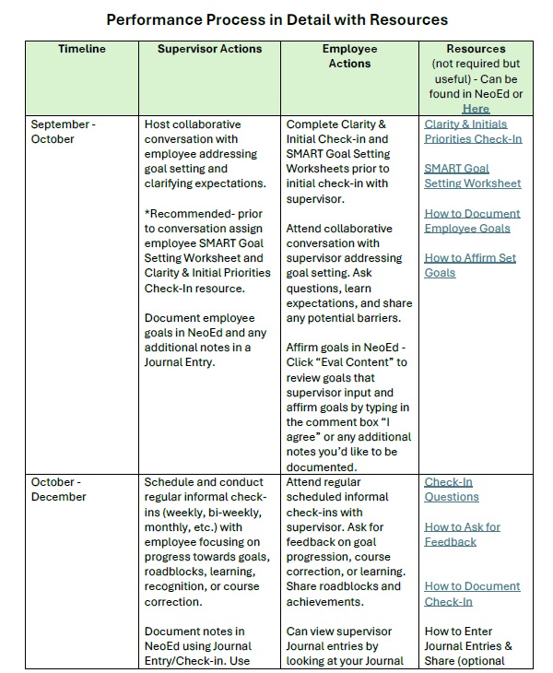
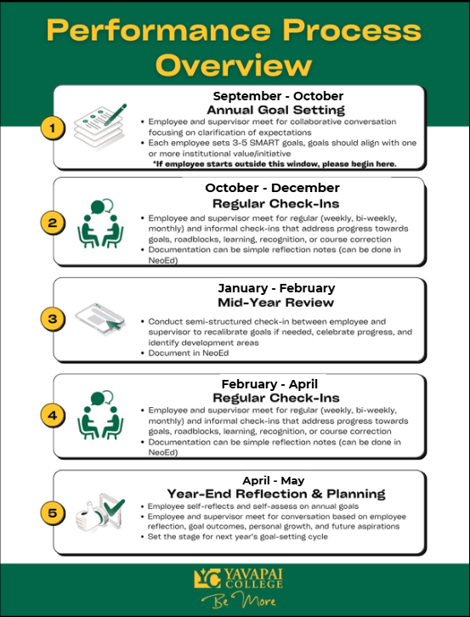
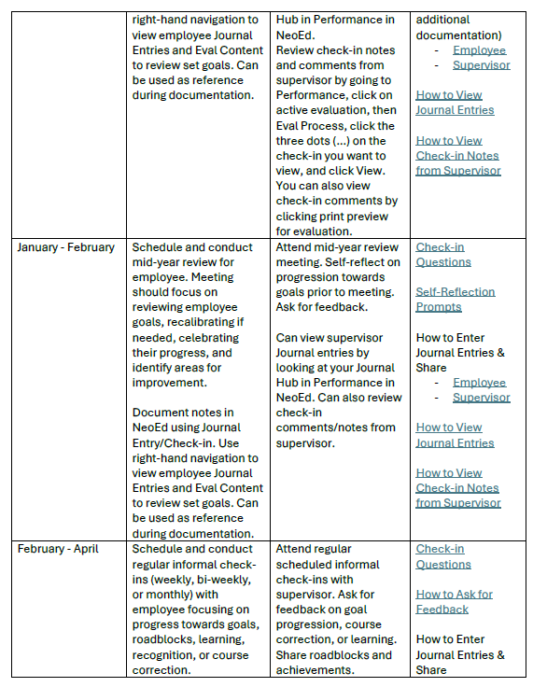
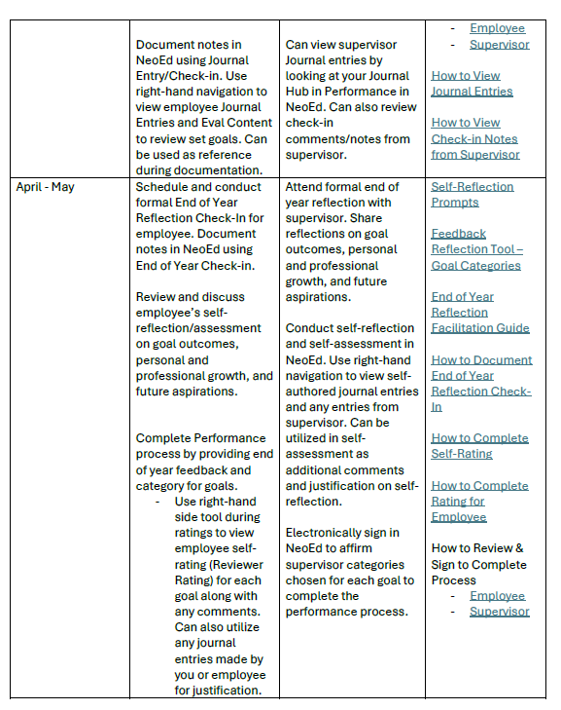

Slide 10
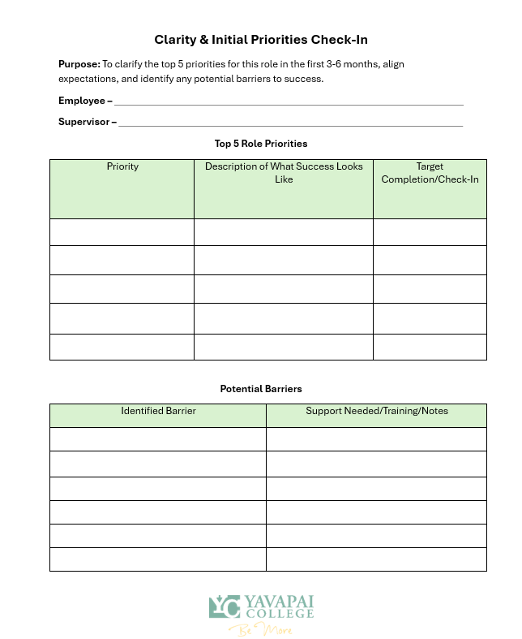
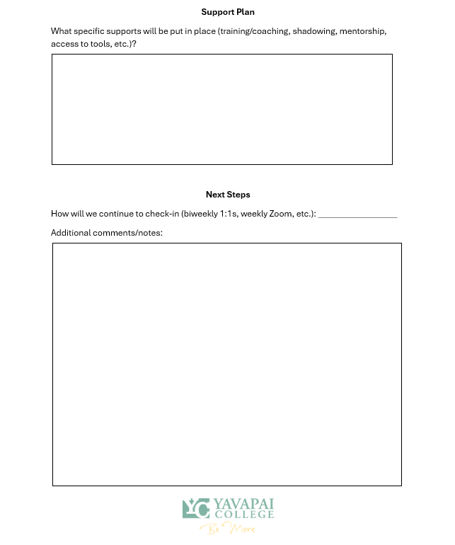

Slide 11
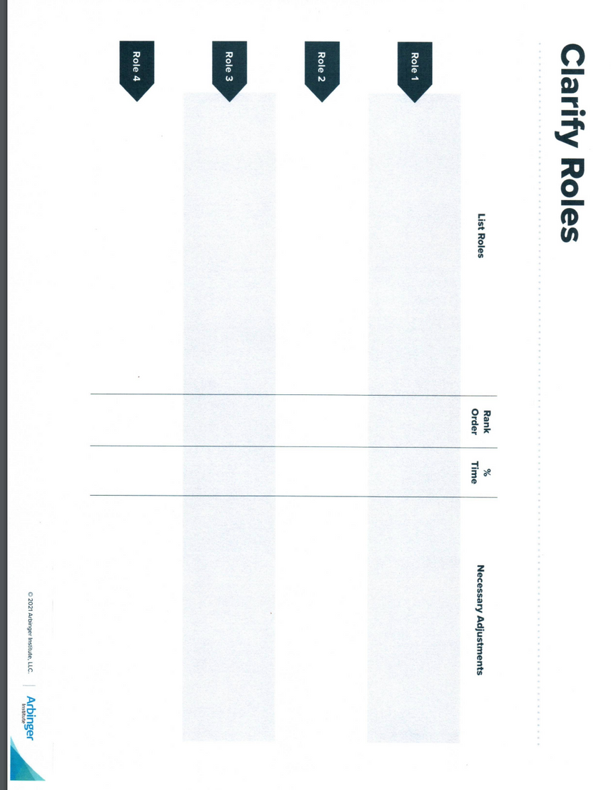
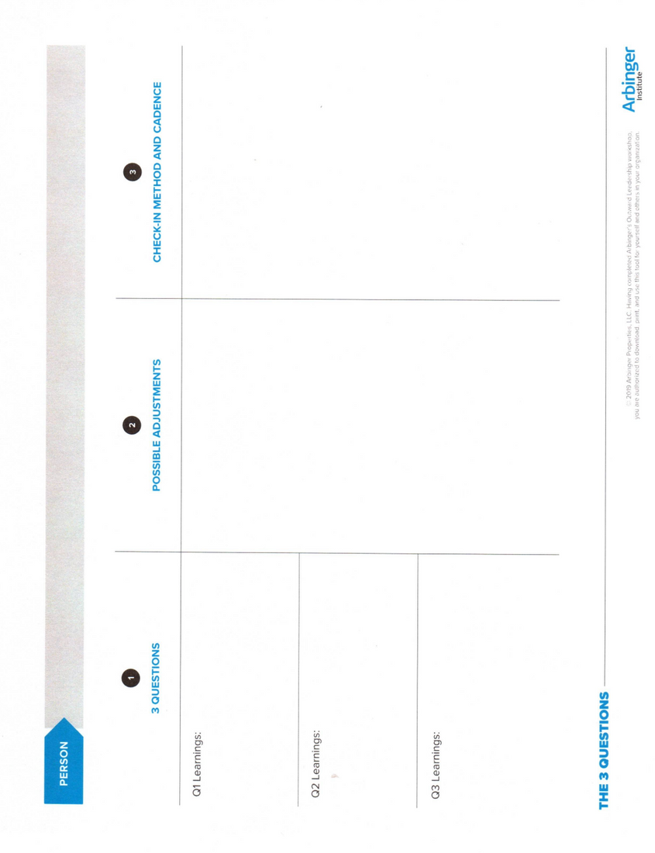
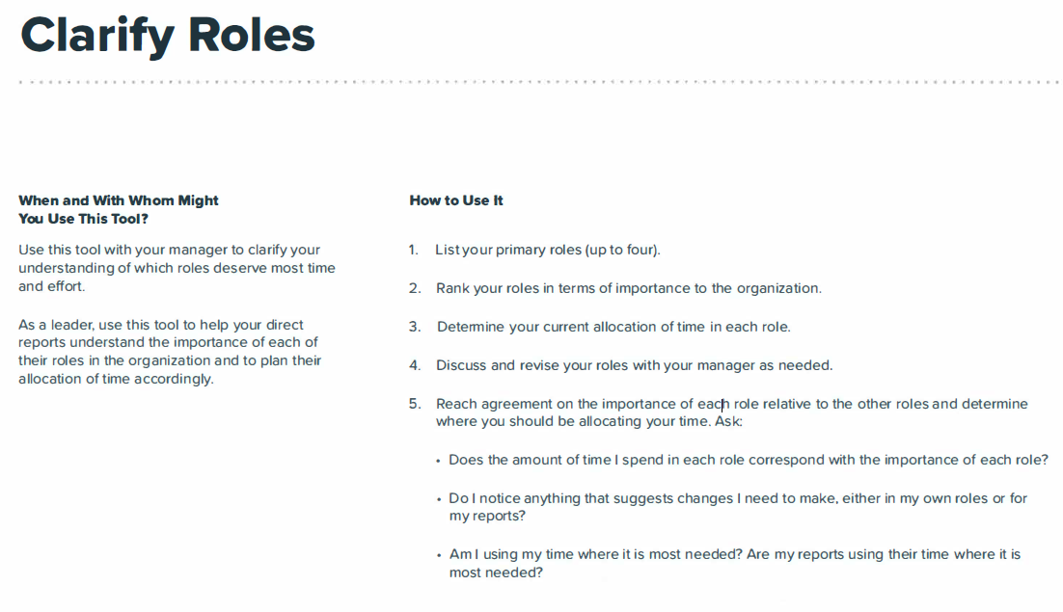
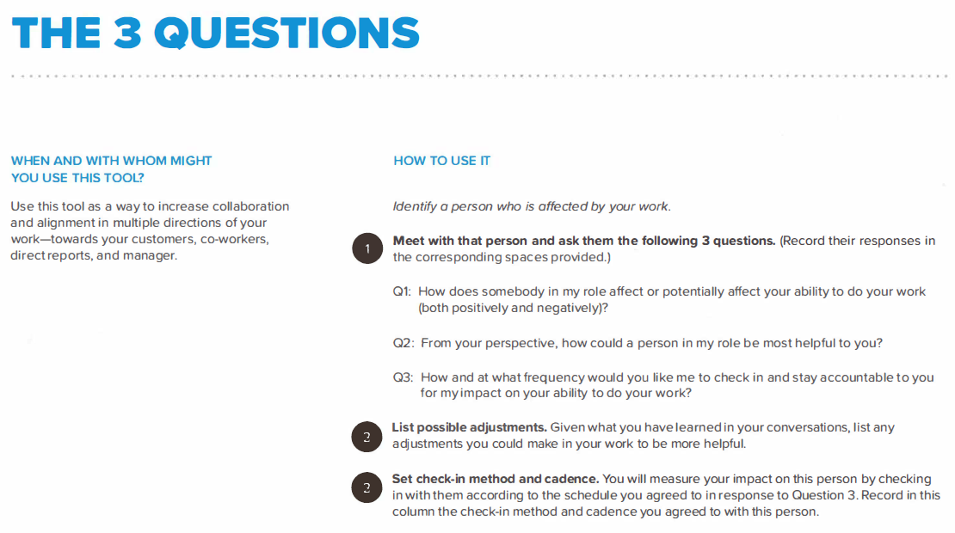
OUTWARD MINDEST RESOURCES
Notes:
Clarifying roles worksheet from Arbinger Institute - employee and supervisor should both fill out by listing all the roles the specific position may have, rank the roles by importance, and provide a percentage of how much time is allocated for that role. Finally, the employee can talk about any adjustments that may be needed.
The 3 Questions - supervisors use to support and identify how they can increase collaboration with direct reports. The 3 questions are:
1. How does somebody in my role affect or potentially affect your ability to do your work? (both positively and negatively)
2. From your perspective, how can a person in my role be most helpful to you?
3. How and at what frequency would you like me to check-in and stay accountable to you for my impact on your ability to do your work?

Slide 12
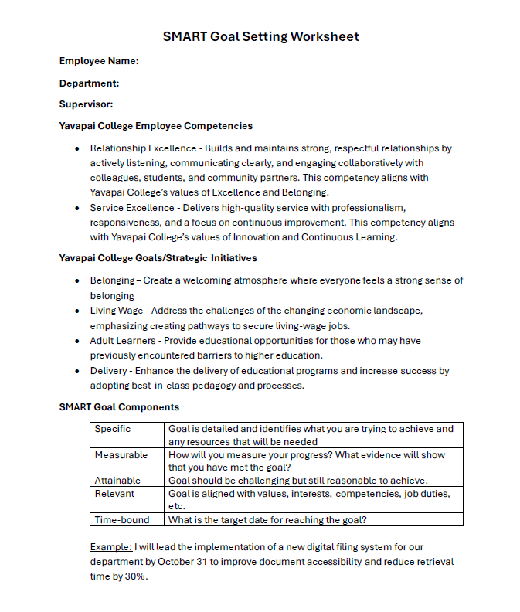
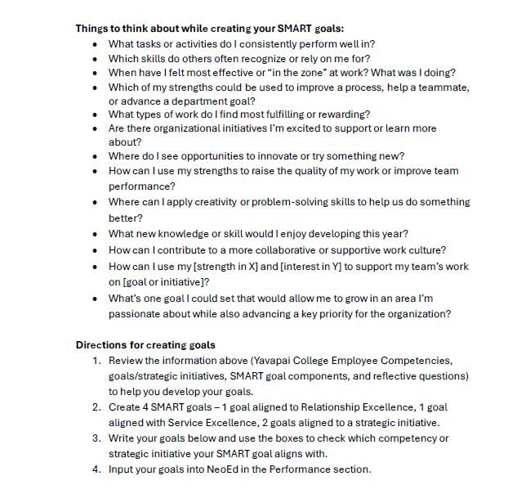
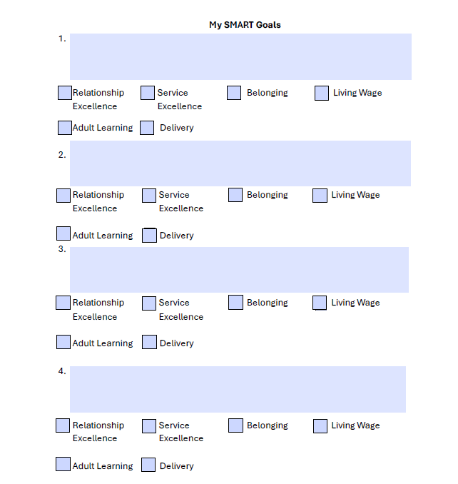

Slide 13
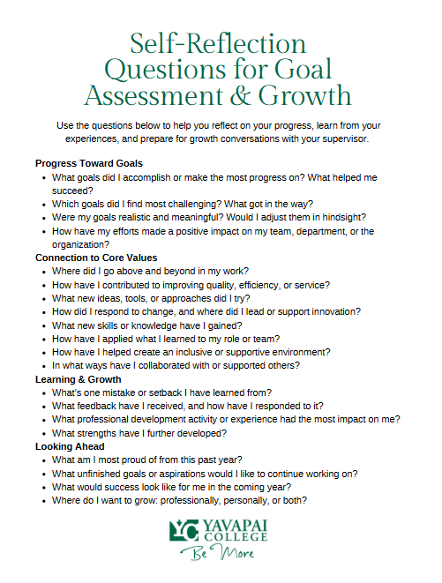
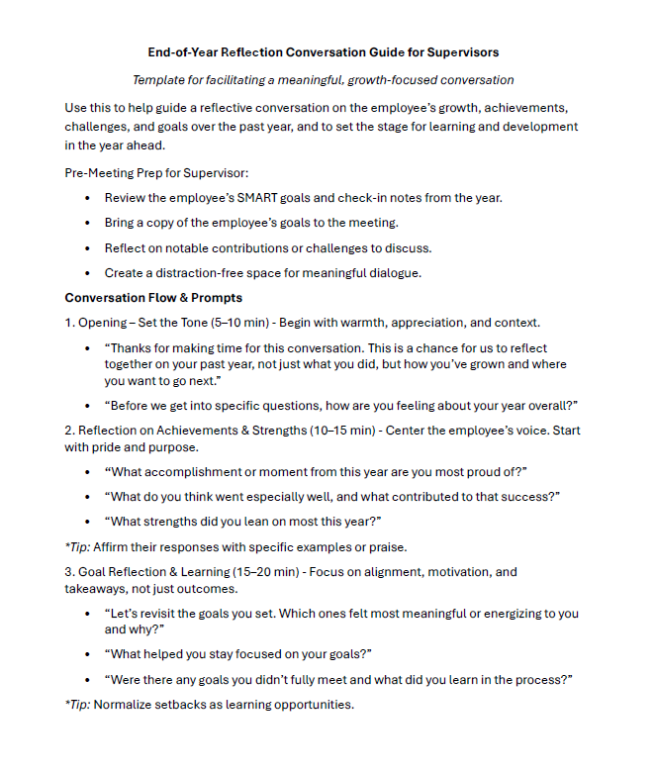
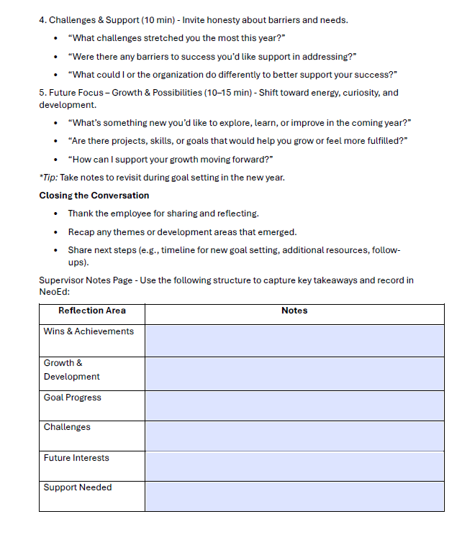

Slide 14
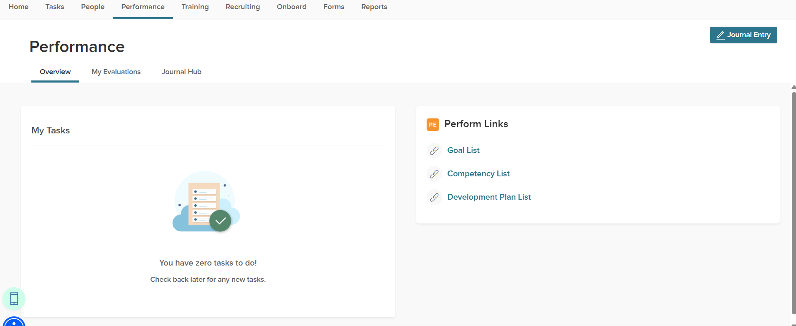
NEOED DOCUMENTATION & REVIEW
Use Journal Entry function for documentation

Slide 15
COMMUNICATION PLAN
3-week rollout
Week 1 - Introduce New Process
Share the why
Week 2 - What’s Changing & What is Expected
Focus on new approach, growth focused, bullet expectations (goal setup, check-ins, etc.)
Week 3 - Tools and Resources for Success
Creating SMART Goals Guide, Reflection Prompts, Overview of Process (Timeline), etc.)
Share where to access in NeoEd

Slide 16
QUESTIONS & FEEDBACK
What feels helpful?
What’s unclear or missing?
What support would help you feel confident in using this?

Slide 17

“When performance becomes a conversation, people thrive.”
-JASON LAURITSEN

